Slide 1
How to create Carla Package
Using Carla Unreal Engine and matlab roadrunner

Slide 2
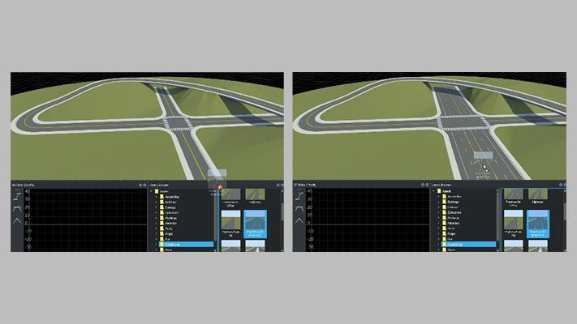
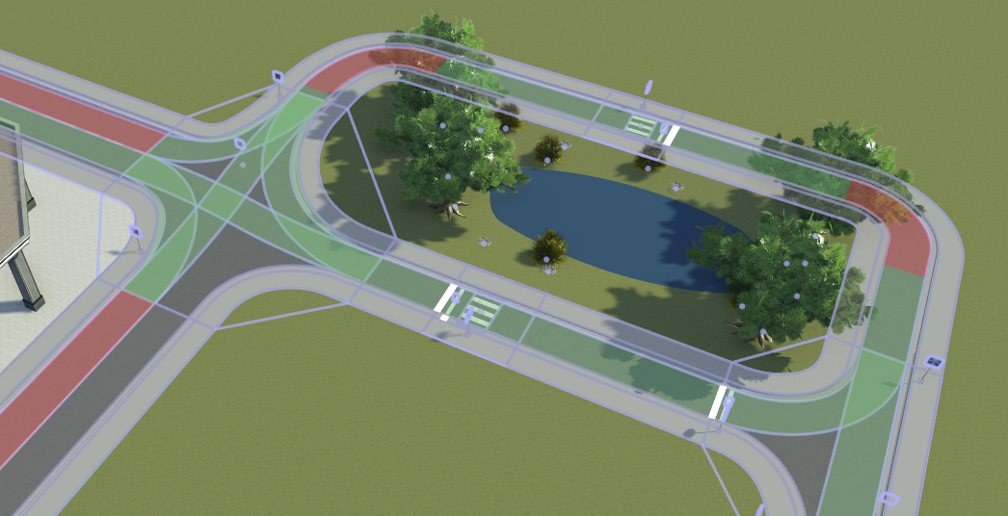
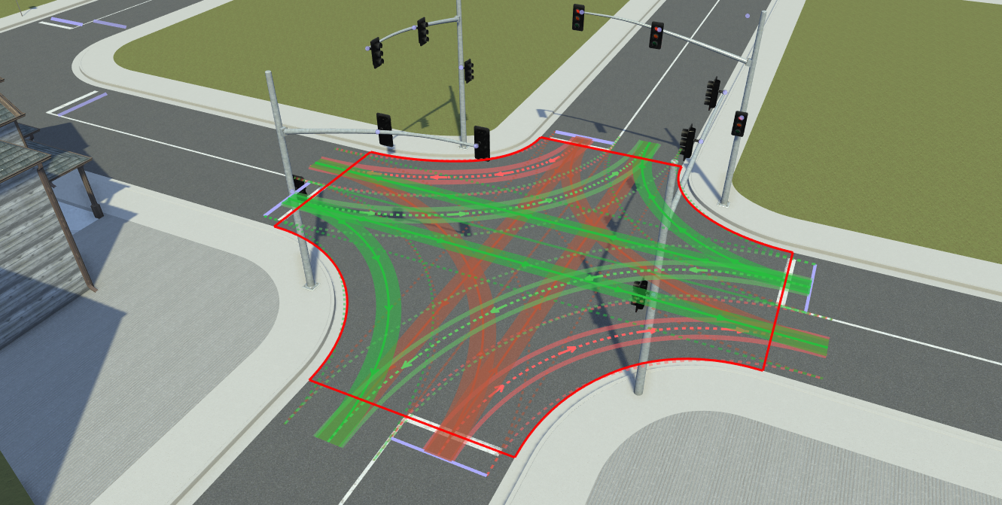
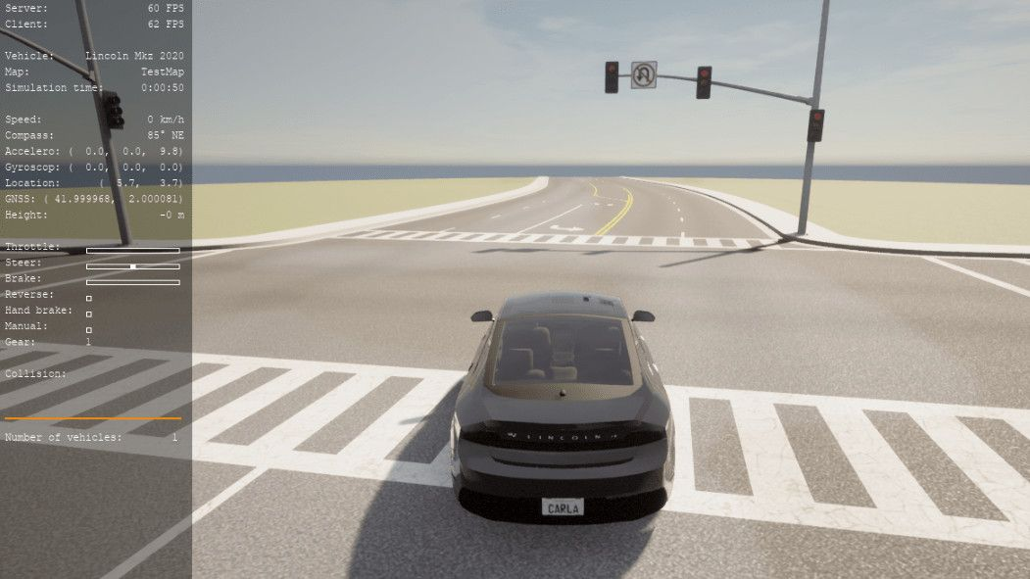
About Roadrunner
Road and 3D scene modelling
Functional Road Network Design
Export to simulators (supported by Carla)
Traffic Signal Rules and Lane Connectivity

Slide 3
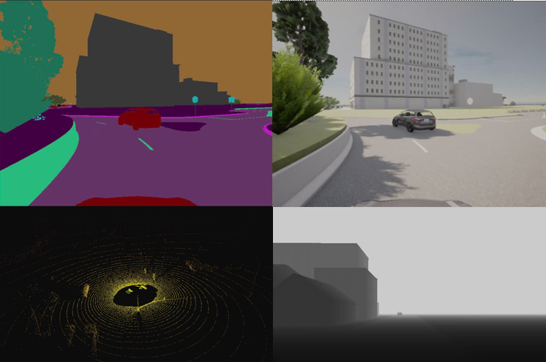
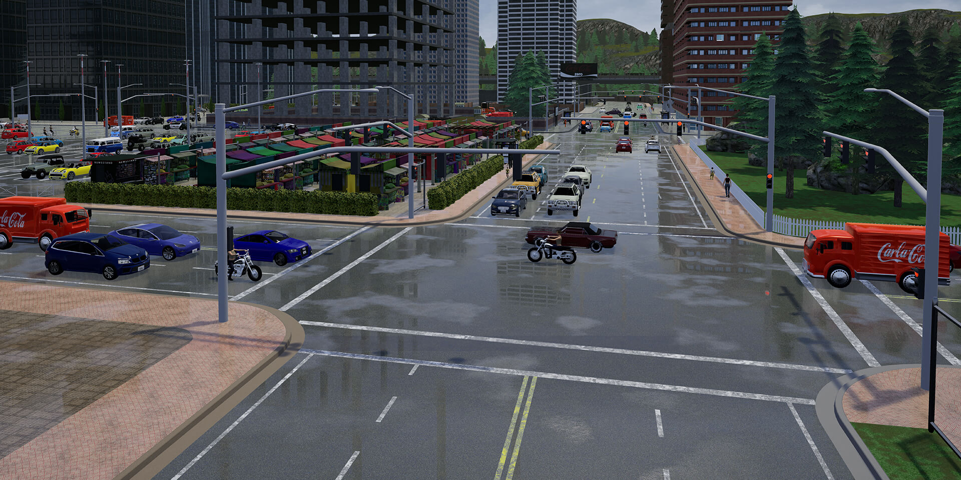
About Carla
Flexible Sensor Suite Integration
(Support up to 17 sensors)
High-Fidelity Urban Simulation

Slide 4
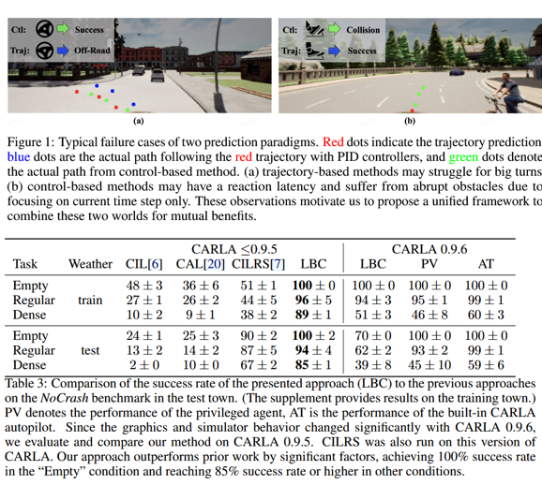
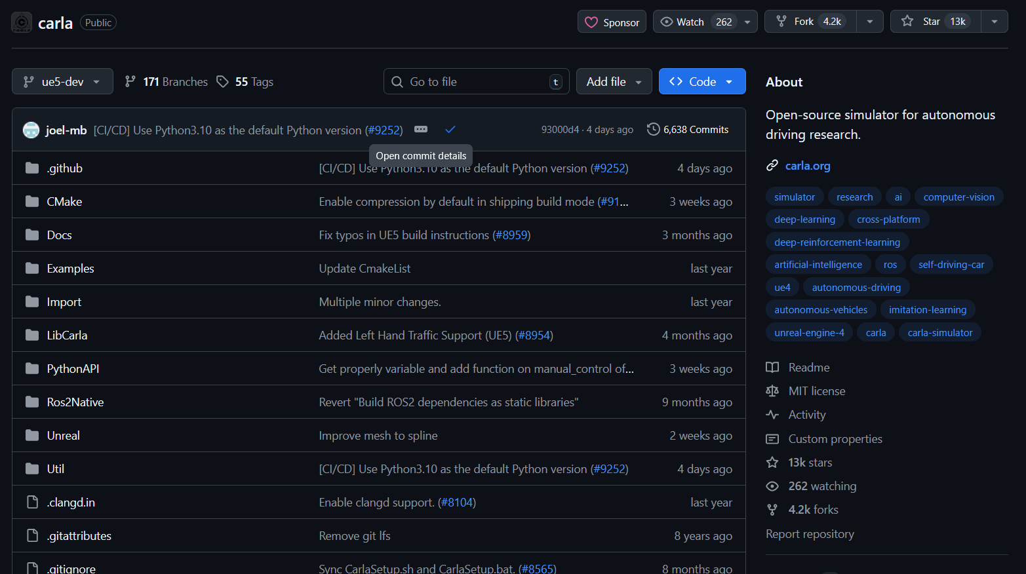
About Carla
Open-Source and Extensible Platform
Benchmarking and Research Support

Slide 5
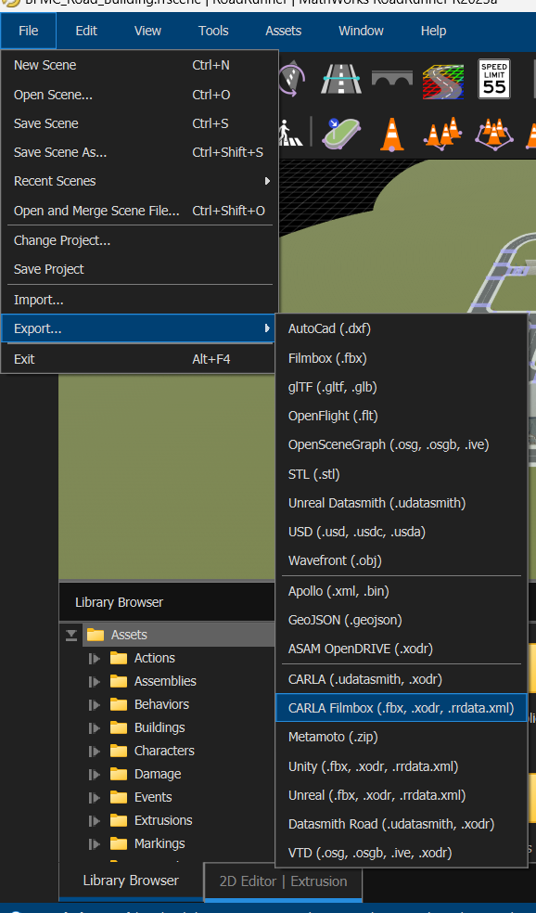
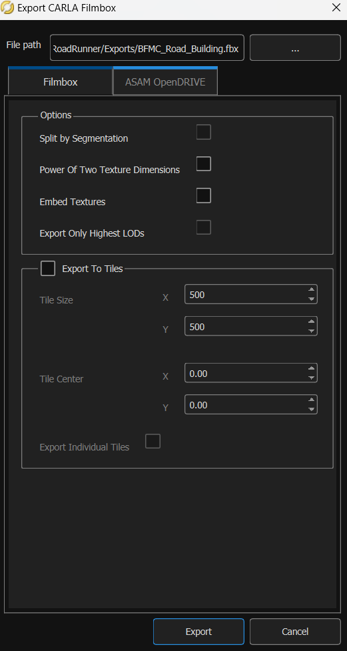
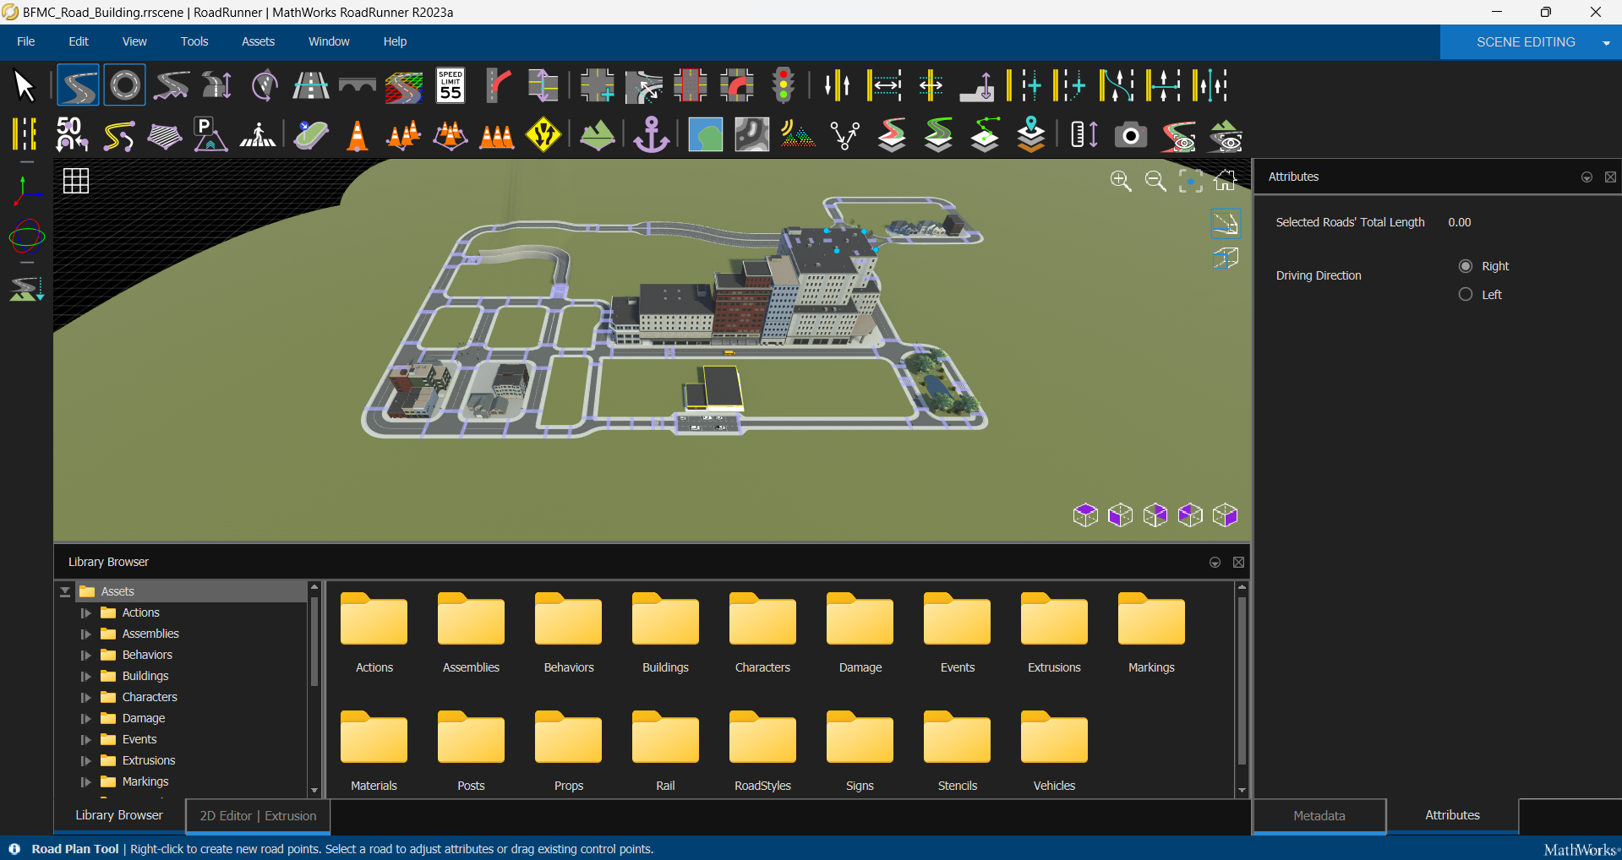
Editor Screen of Roadrunner.
Editing map: https://www.youtube.com/watch?v=zcVTh2dQBn8
Create roundabouts:
https://www.youtube.com/watch?v=wIQdLQoZmfY
Choose File –> Export -> Carla filmbox
Leave Default. Choose export
I. Exporting map from Roadrunner to FBX (On Windows)

Slide 6
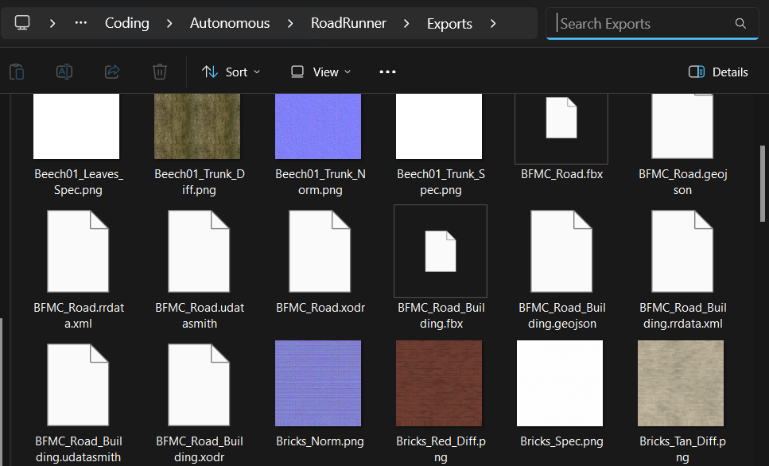
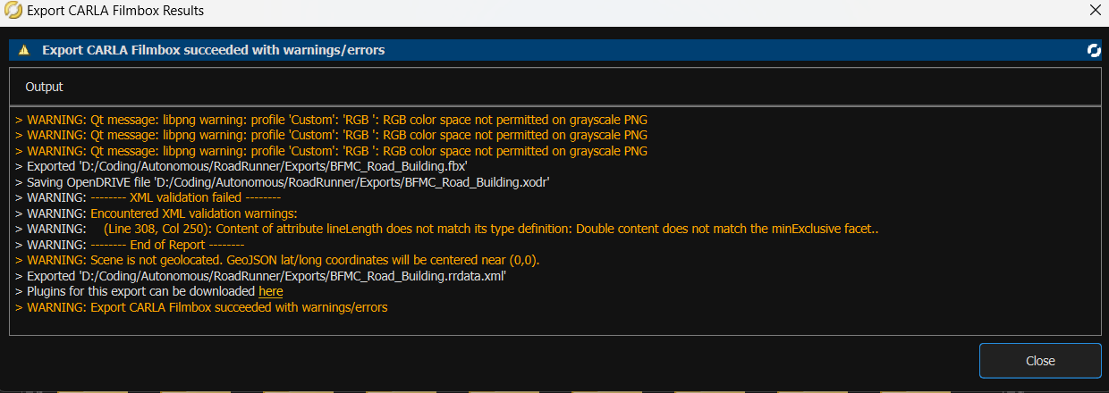
Check if any error occurs (usually on junctions and roundabouts and highlighted in red)
Check if the software has exported the correct file
I. Exporting map from Roadrunner to FBX (On Windows)

Slide 7
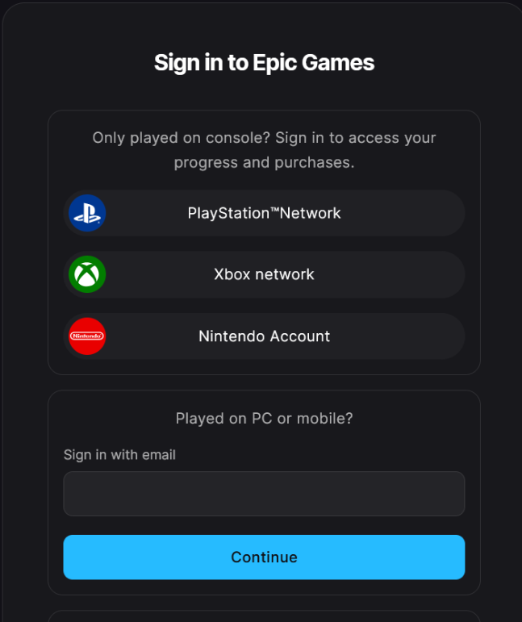
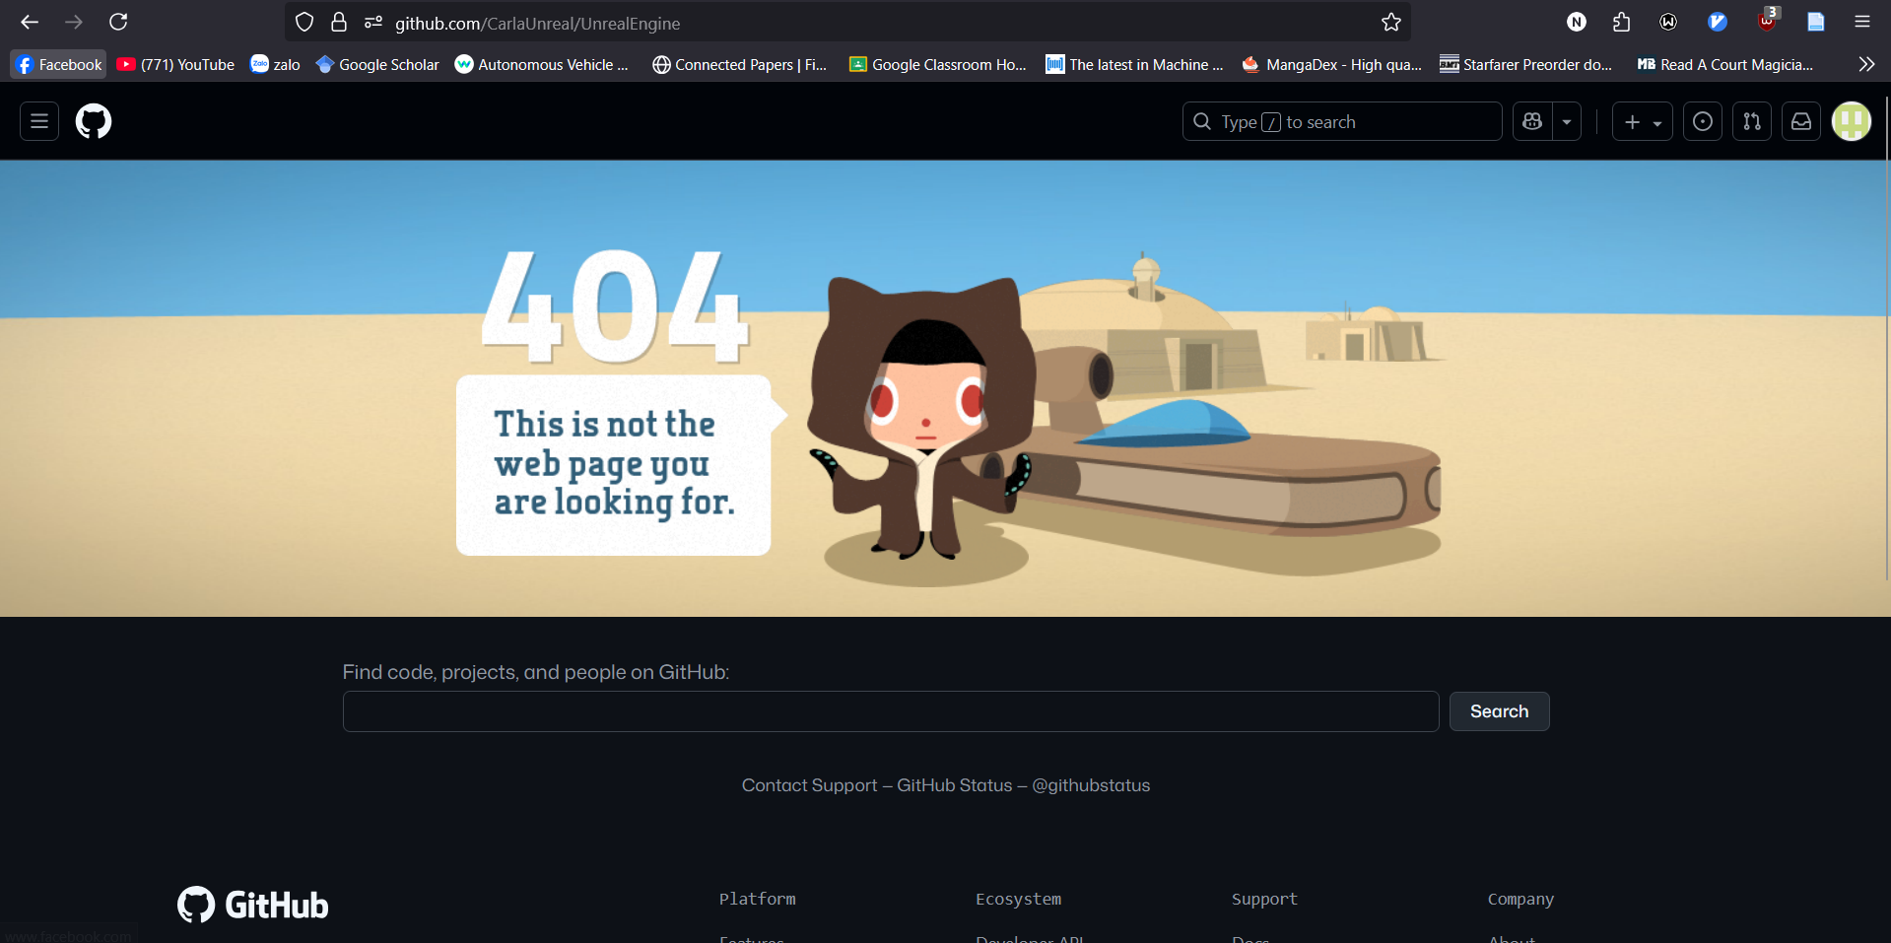
Unreal Engine repo is private. Direct access not available
Epic Games account and license agreement required.
II. Building Carla Unreal Engine: Accessing Unreal Engine Repo

Slide 8
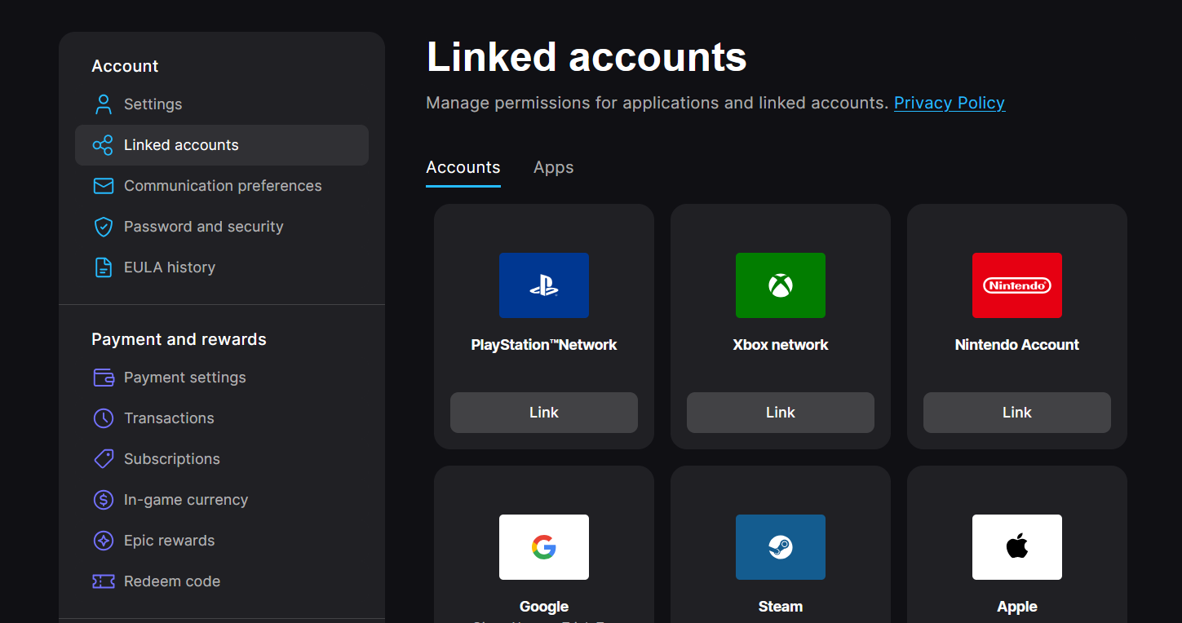
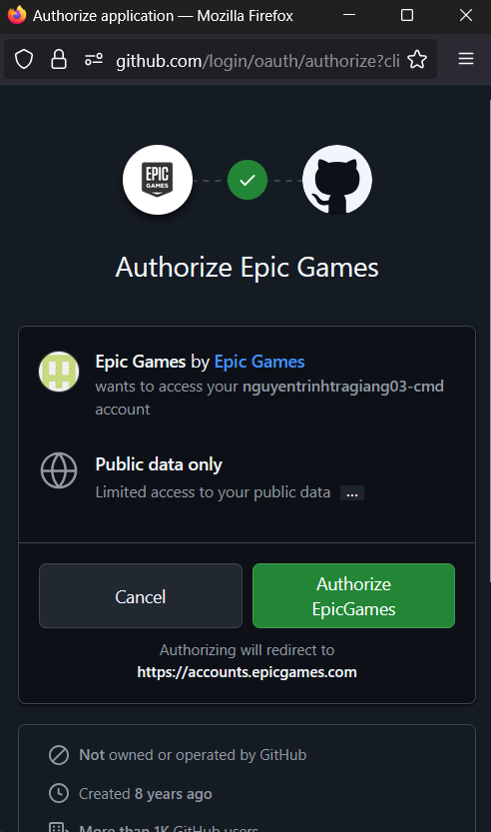
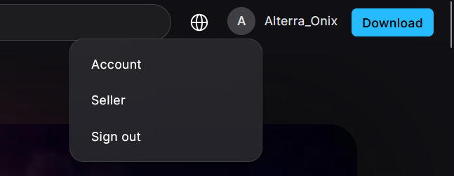
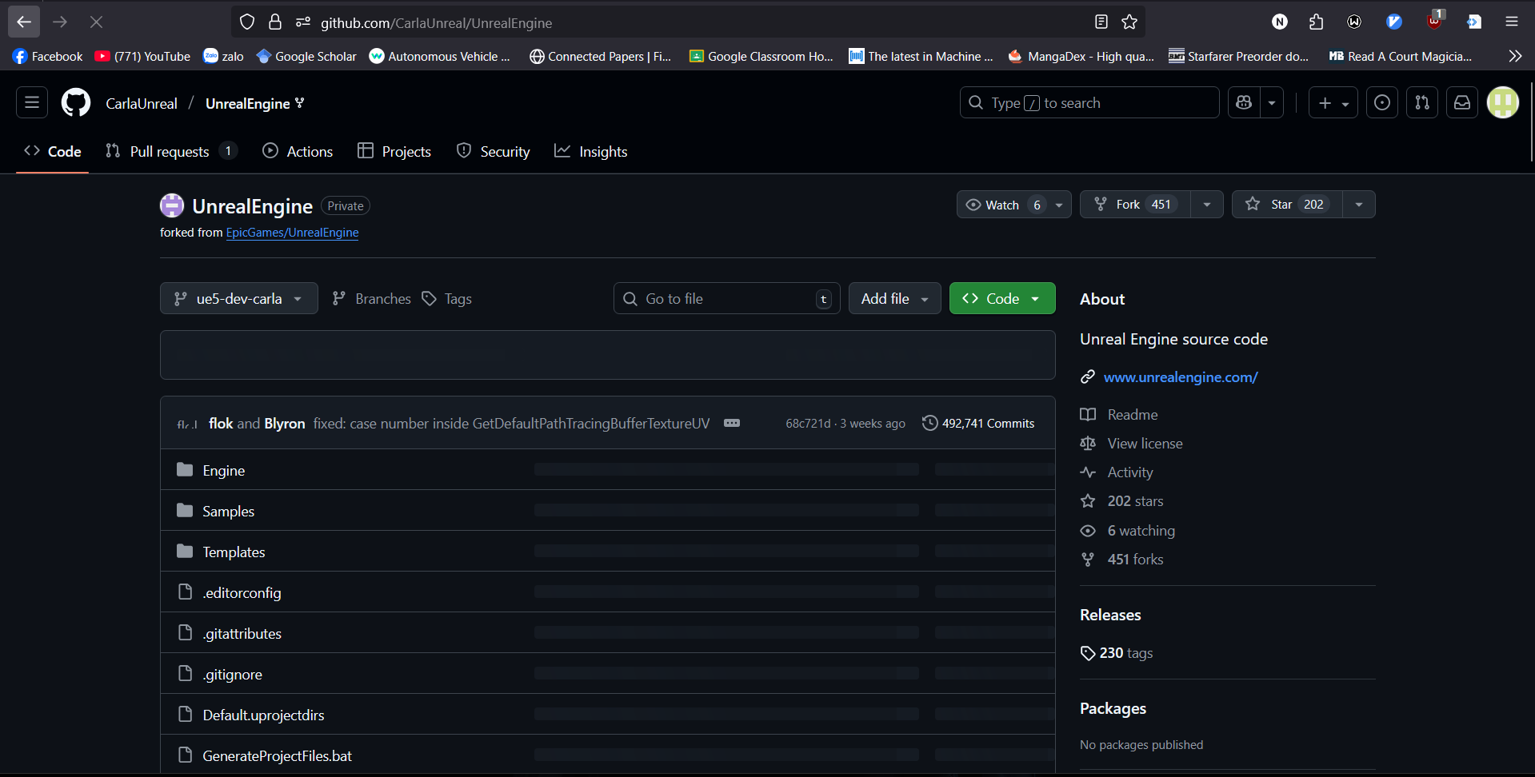
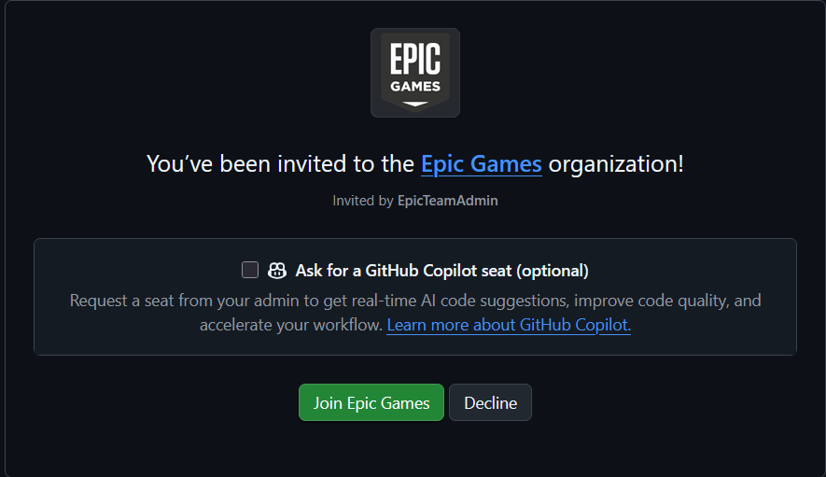
Access account options from Epic Games website
Navigate to Linked Accounts and connect GitHub.
Authorize GitHub Access
Carla Unreal Engine is now available for cloning
Epic Games sent invitation to join organization
II. Building Carla Unreal Engine: Accessing Unreal Engine Repo

Slide 9
Access account options from Epic Games website
Navigate to Linked Accounts and connect GitHub.
Authorize GitHub Access
Carla Unreal Engine is now available for cloning
Epic Games sent invitation to join organization
II. Building Carla Unreal Engine: Accessing Unreal Engine Repo

